Slide 1

The Portable Goniometer For Measuring BRDF
Kendall Koga

Slide 2
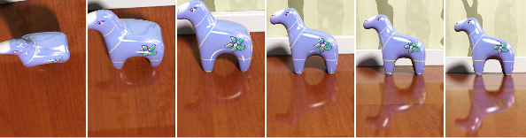
Bidirectional Reflectance Distribution Function (BRDF)
BRDF is a property of any surface as light scatters off it.
Surface properties can be derived using the amount of light scattered at all angles relative to the angle of incidence.

Slide 3
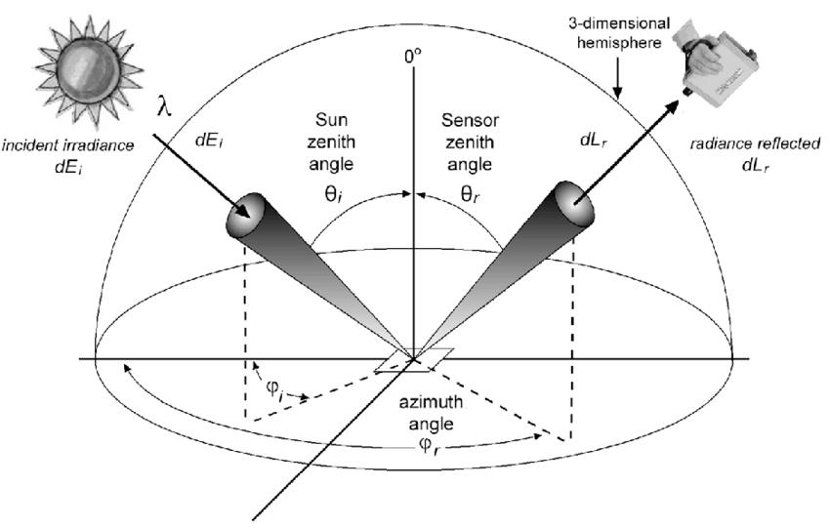

Measuring BRDF
BRDF can be calculated by comparing the flux of reflected radiation and comparing it to the flux of a sample with a known BRDF using the equation:
Using this method, we can determine the composition of a unknown sample.
$${BRDF}_{sample}=\frac{{Flux}_{sample}}{{Flux}_{reference}}∗{BRDF}_{reference}$$

Slide 4
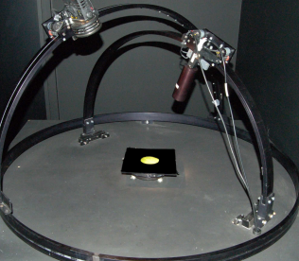
Traditional BRDF Goniometry
Traditional Goniometers for measuring BRDF:
  Can have a limited range of measurements
  Cumbersome
  Difficult to set up
  Gathering data can take a significant amount of time due to single point measurements

Slide 5
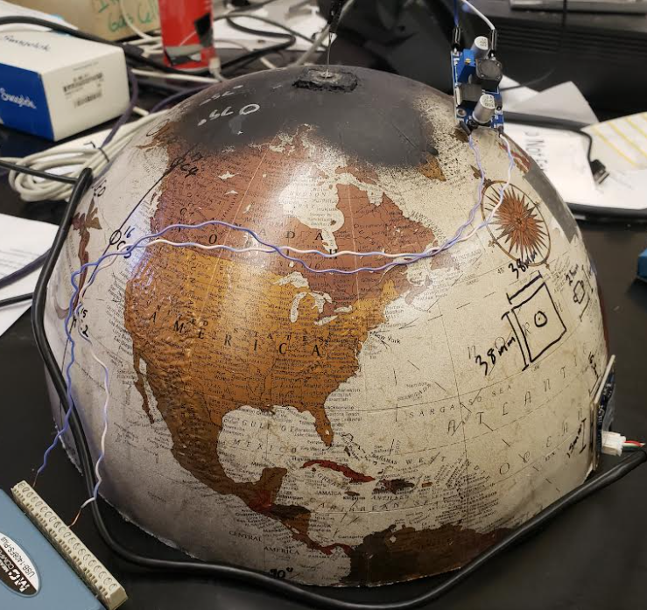
The Portable Goniometer
Our new proof of concept prototype:
  Compact
  Easy to set up
  No moving parts
  Performs multiple measurements at once
Researchers will be able to take a wide range of BRDF measurements either in a lab or in the field.

Slide 6
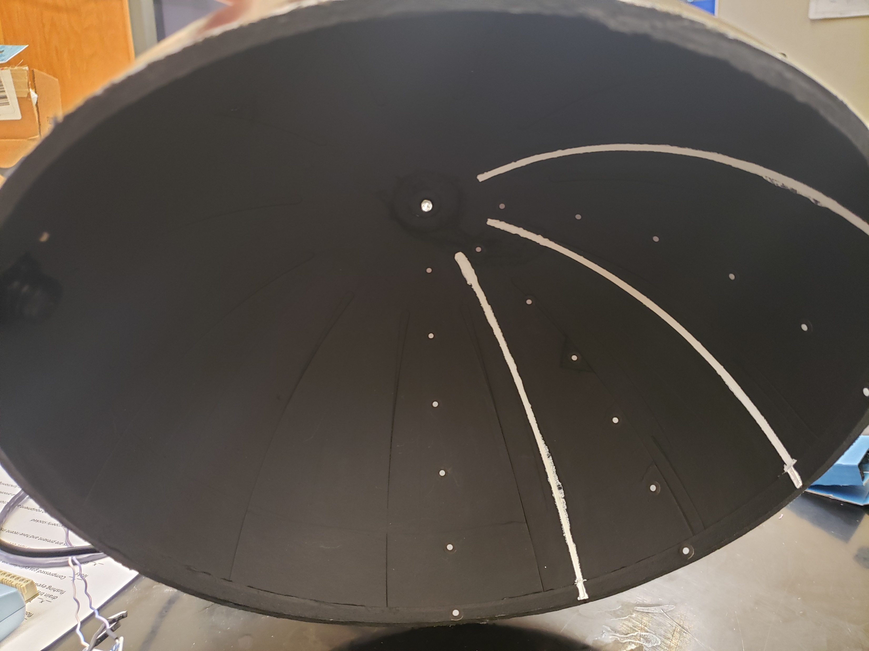
Hardware
The device uses a dome with strategically placed light sources that illuminate a sample which in turn illuminates a series of reflective lines.
An internal camera captures an image of the reflective lines, then software processes the image to obtain data.

Slide 7
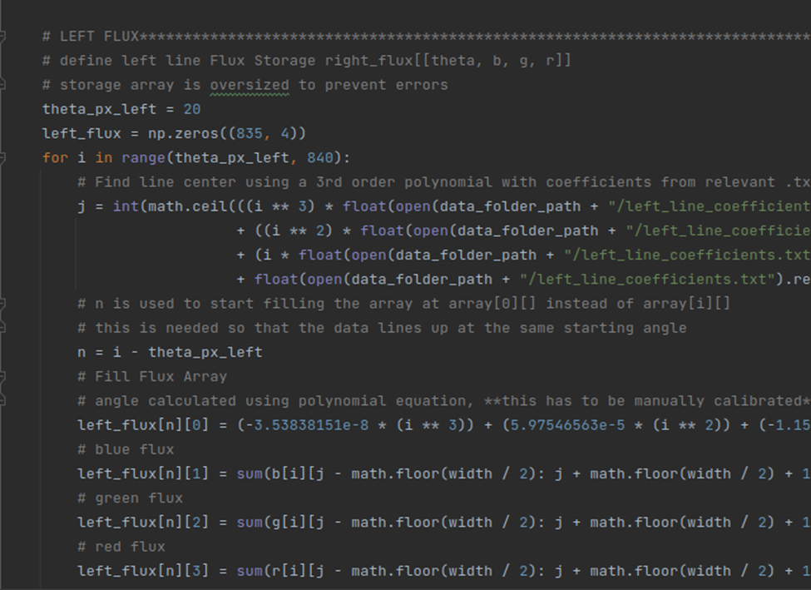
Software
When the image is captured, software saves pixel values (0-255) from the reflective lines to an excel spreadsheet.
Adding up pixel values for a given area on the line provides the total flux for that area.

Slide 8
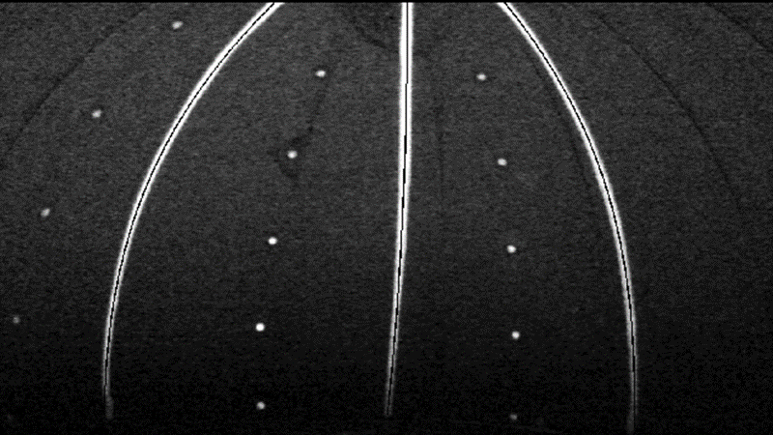

Slide 9
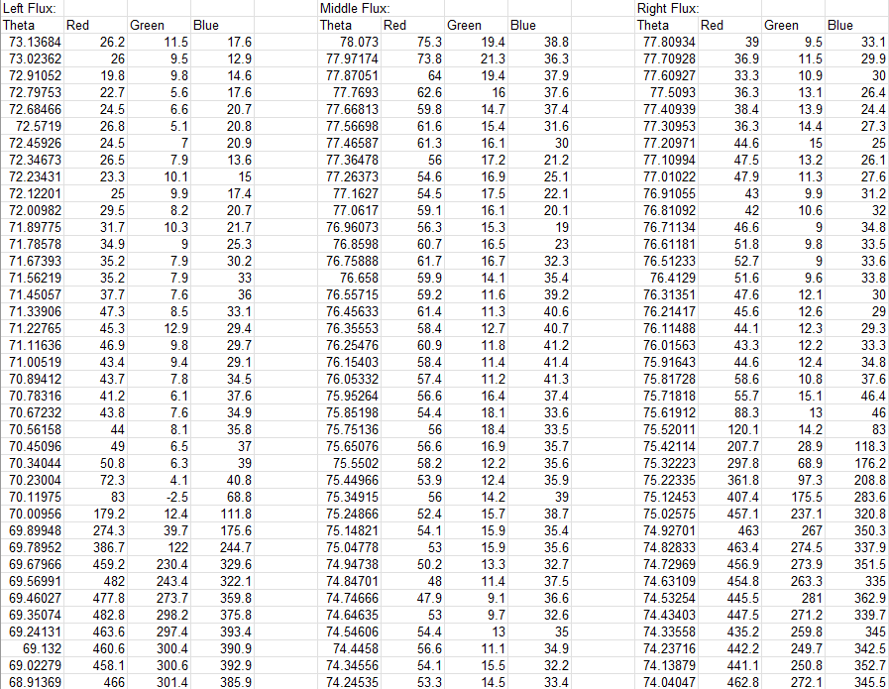
Data
Raw data is saved for individual horizontal lines of pixels that fall on the reflective lines.
Each line of pixels is mapped to a corresponding angle according to a calibration algorithm.
More than 7,000 data points are collected with every sample.

Slide 10
Future Development
Upgrade the software to calculate the flux of light reflected off the lines in 1° x 1°squares.
  Flux will be calculated by adding up pixel values for given areas on the lines.
Add more LEDs for a wider angle of incidence range.
Experiment with different cameras.
  Hyperspectral camera to gather spectra in addition of flux based BRDF.
  Higher resolution cameras could allow for a more compact design.

Slide 11
Thank You
Kendall Koga
kjk284@nau.edu
kendallkoga@gmail.com

